Slide 1

Supermarket Sales Prediction
Final Project
Supervised by: Dr. Doaa Mahmoud
Facilitator: Eng. Haneen Hossam
Ahmed Ali Omar
Senior student at faculty of AI, Kafrelsheikh University

Slide 2
Agenda
Data Info
The objective
EDA
Modelling
Business Solution
Recommendations

Slide 3
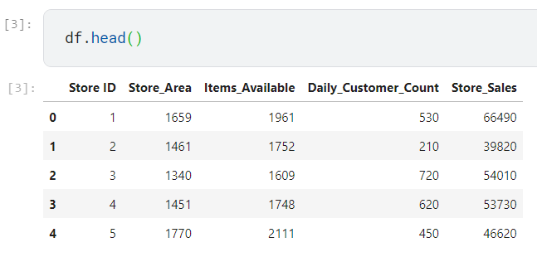
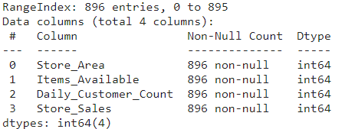
Data Info
There are 5 columns in the dataset, each are:
1. Store ID: (Index) ID of the particular store.
2. Store_Area: Physical Area of the store in yard square.
3. Items_Available: Number of different items available in the corresponding store.
4. DailyCustomerCount: No. of customers who visited to stores on an average over month.
5. Store_Sales: Sales in (US $) that stores made.

Slide 4
The Objective
Our objective is to increase sales in the store.
The goal is to determine which customers want to buy with the lowest cost, and which customers want value service more.

Slide 5
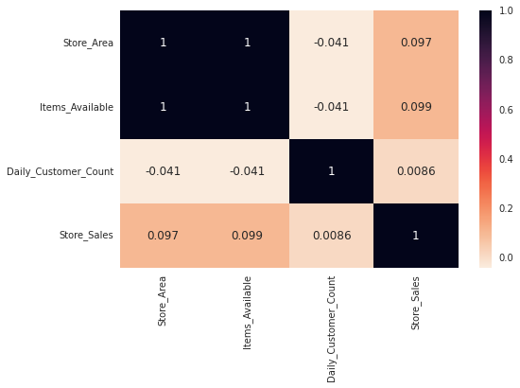
Exploratory Data Analysis
The correlation between features:

Slide 6
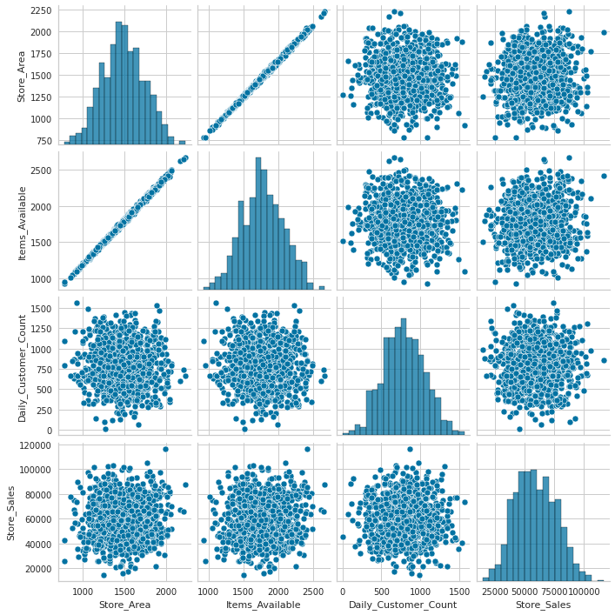
Exploratory Data Analysis (EDA)
EDA
As we see, each columns are distributed normally.

Slide 7
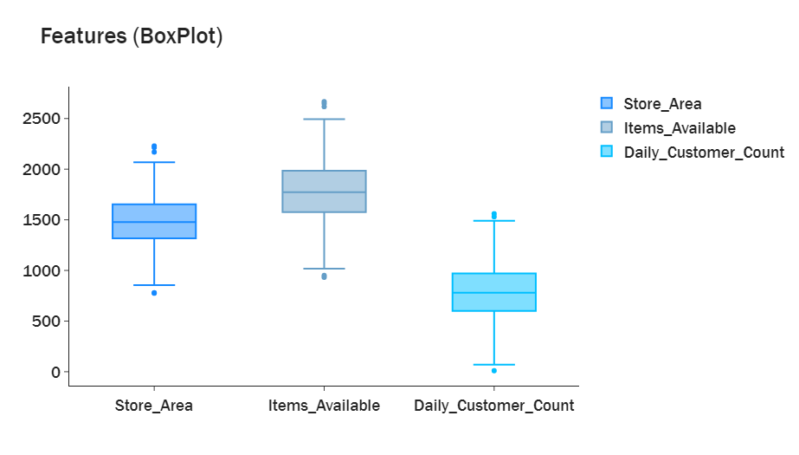
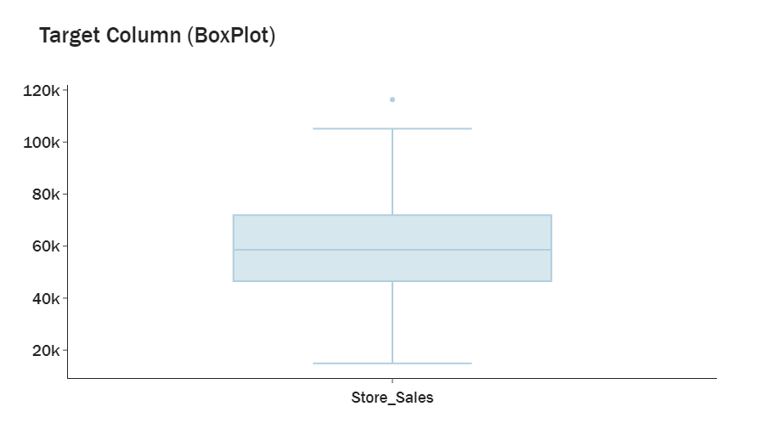
Exploratory Data Analysis (EDA)
EDA

Slide 8
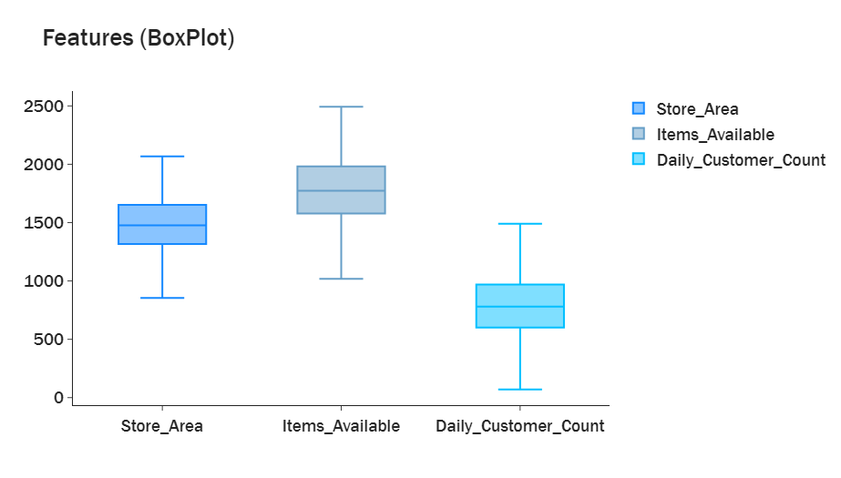
Exploratory Data Analysis (EDA)
EDA

Slide 9
Exploratory Data Analysis (EDA)
EDA

Slide 10
Modeling
Models Used:
Random Forest Regressor
Linear Regression
Decision Tree Regressor
XGB Regressor
LGBM Regressor
Cat Boost Regressor
EDA

Slide 11
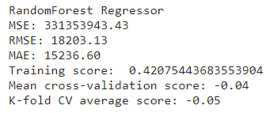
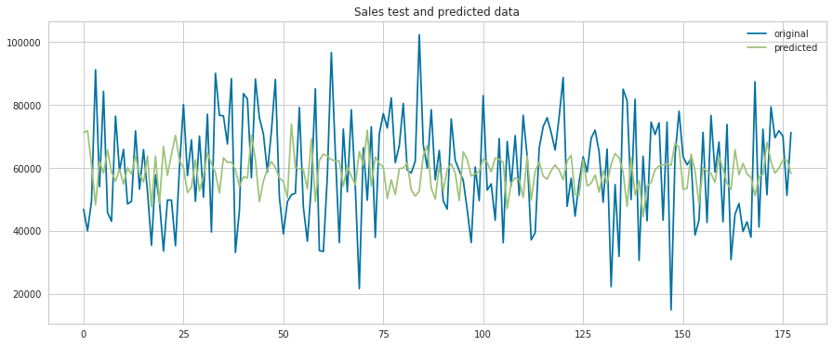
1- Random Forest
Before clustering

Slide 12
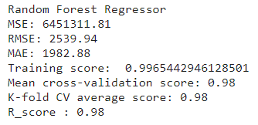
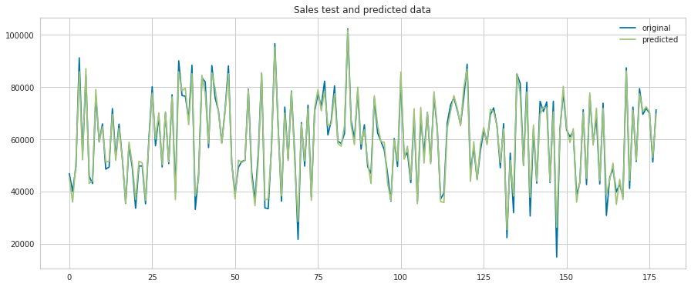
1- Random Forest
After clustering

Slide 13
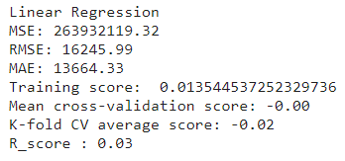

2- Linear Regression

Slide 14
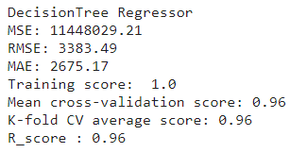
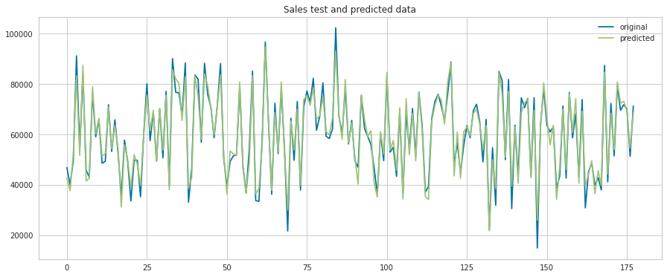
3- Decision Tree

Slide 15
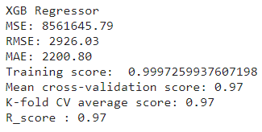
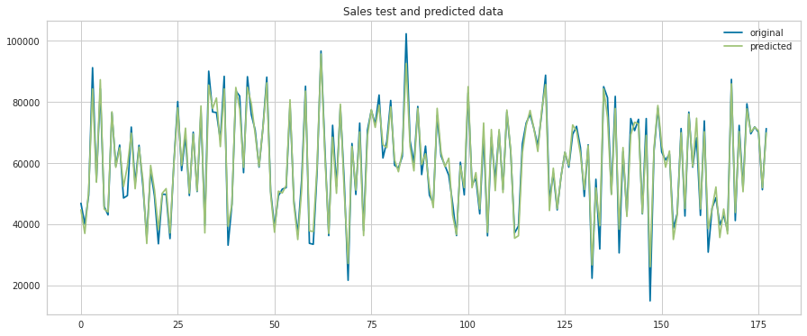
4- XGB Regressor

Slide 16
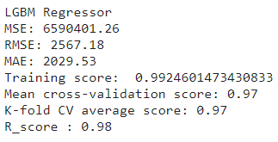
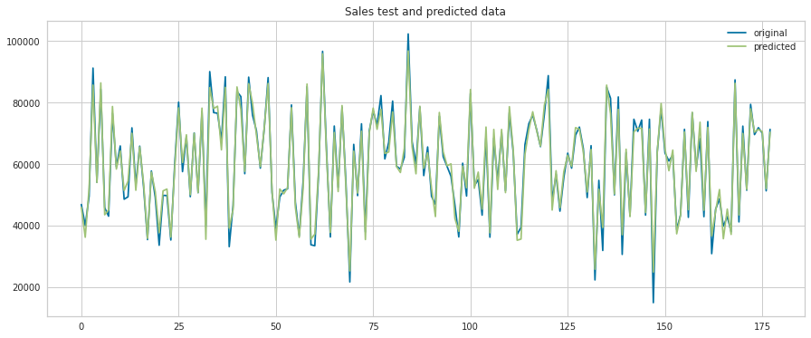
5- LGBM Regressor

Slide 17
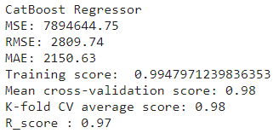

6- CatBoost Regressor

Slide 18
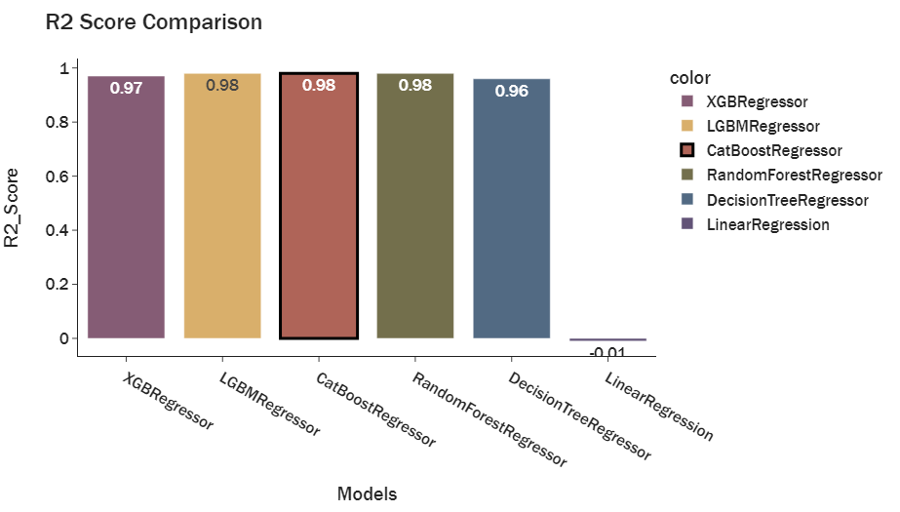
Model Comparison
EDA

Slide 19
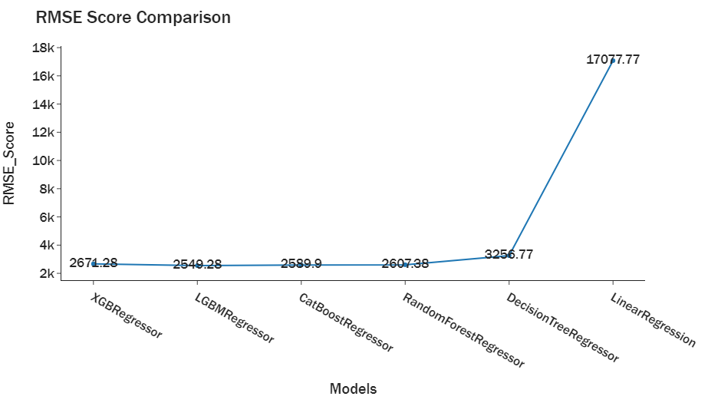
Model Comparison
EDA

Slide 20
Business Solution
Our objective is to increase sales in the store.
The goal is to determine which customers want to buy with the lowest cost, and which customers want value service more.

Slide 21
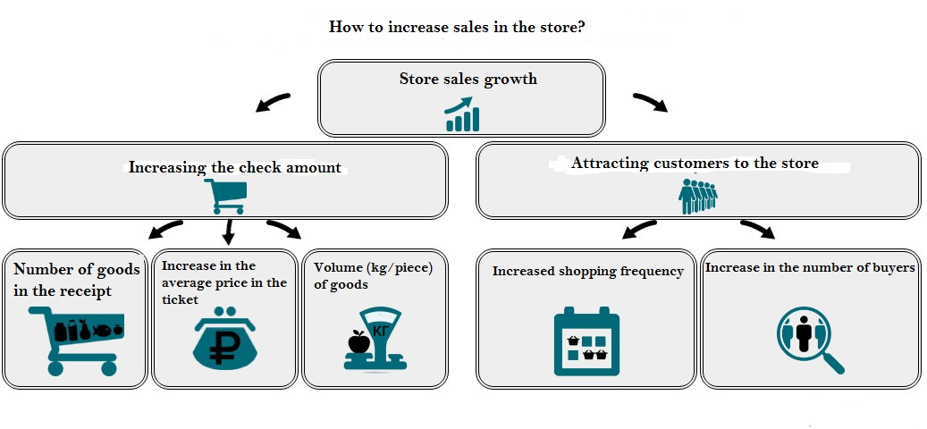
Recommendation

Slide 22
Thank You!
Any Questions?

